Slide 1
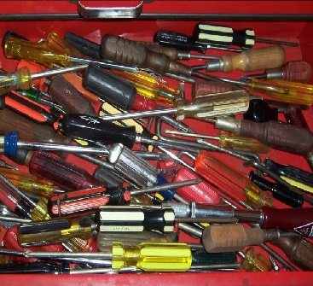
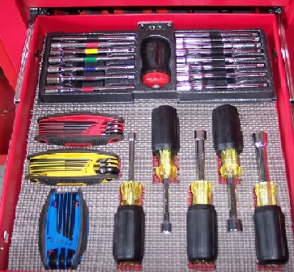
Drone information on the Internet
Drone information on DroneSpeak
dronespeak.com

